Slide 1
Lab 3 – Hierarchical Clustering,
DBScan & Silhouette Scores
CS 506

Slide 2
Hierarchical Clustering

Slide 3
Hierarchical Clustering
Top-down (divisive): the reverse process — start with all points in one cluster and repeatedly split it; less common in practice, and out of scope for the class
Bottom-up (agglomerative): every point starts as its own cluster
Repeatedly merge the two closest clusters
Stop when only one cluster remains — this builds a full tree of merges
No need to choose k up front — we decide afterward, by cutting the tree

Slide 4
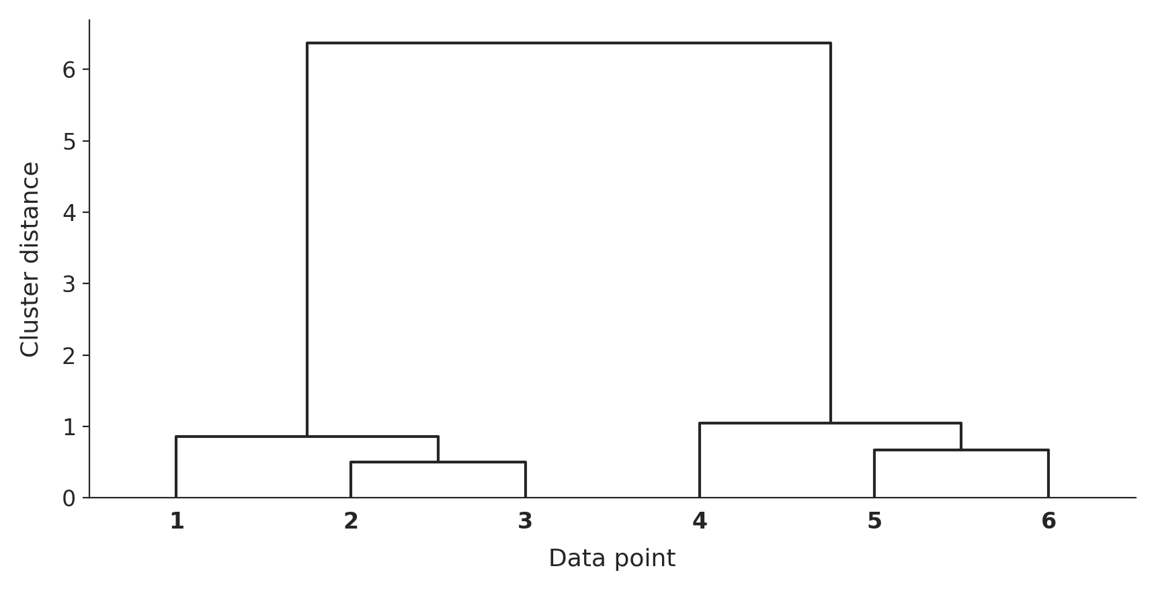
Reading a Dendrogram
Notes:
x-axis: individual data points. y-axis: the distance at which two clusters were merged. The higher a merge happens, the less similar the two things being joined were.

Slide 5
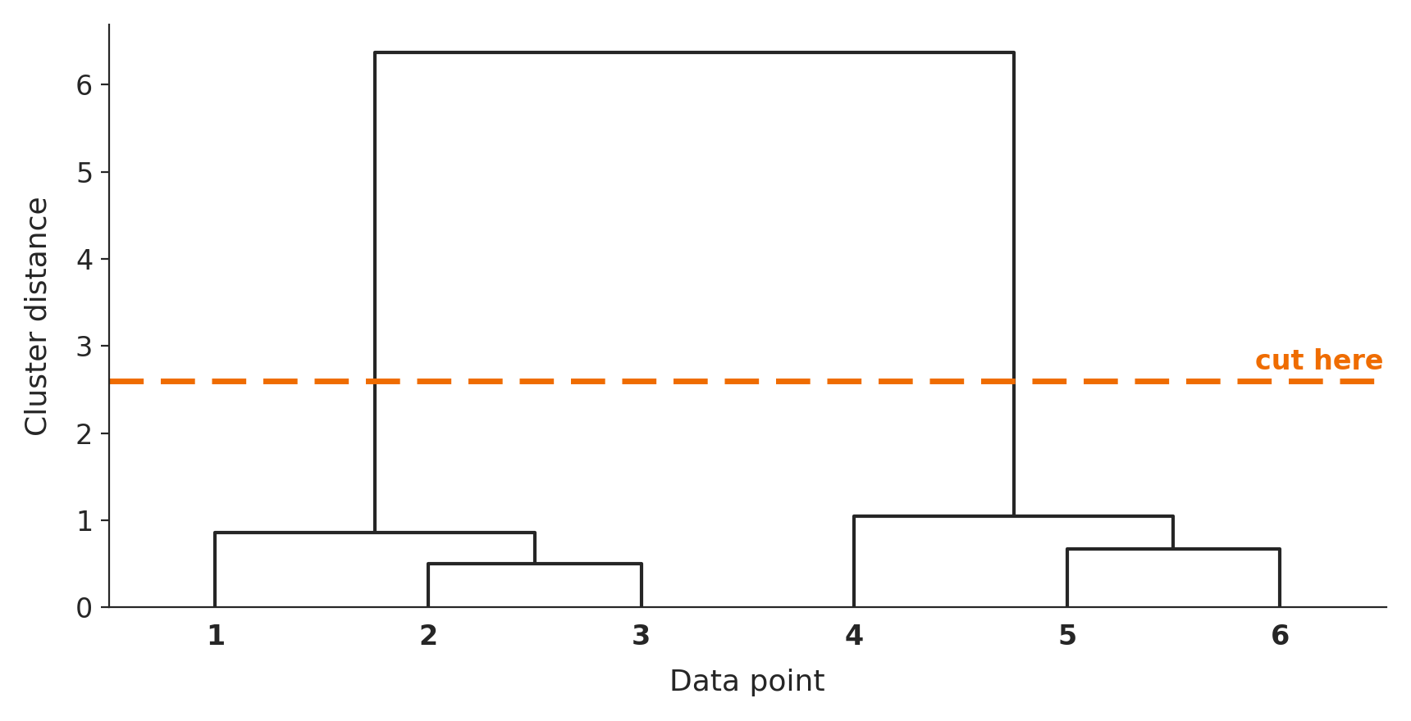
Cutting the Dendrogram = Choosing k
Draw a horizontal line at any height — the number of vertical branches it crosses is your number of clusters.
Notes:
At this height the line crosses 3 branches -> 3 clusters. Cut higher and fewer branches are crossed -> fewer, coarser clusters.

Slide 6
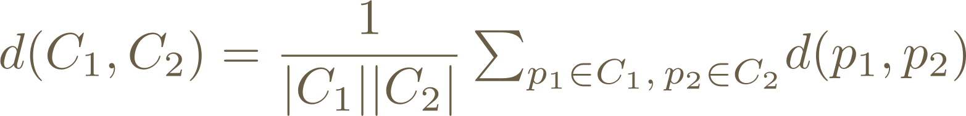

Recall: Link Functions
Purpose: define the distance between two clusters (not just two points)
Single-link: distance between the closest pair of points, one from each cluster
Complete-link: distance between the farthest pair of points
Average-link: the average distance over every cross-cluster pair
Centroid distance: distance between the two clusters' centroids
Ward's distance: the increase in within-cluster variance caused by merging

Slide 7




Example
What would merge next under single-link distance?
$$B\left(0,3\right)$$
$$A\left(1,2\right)$$
$$C\left(−1,0\right)$$
$$D\left(2,0\right)$$

Slide 8
Do not edit
How to change the design
What would merge next under single-link distance?
The Slido app must be installed on every computer you’re presenting from

Slide 9




Example
What would merge next under single-link distance?
$$B\left(0,3\right)$$
$$D_{SL}\left(C,AB\right)=\min{\{\sqrt{10}},\sqrt{8}\}=\sqrt{8}$$
$$A\left(1,2\right)$$
$$\sqrt{10}$$
$$\sqrt{8}$$
$$C\left(−1,0\right)$$
$$D\left(2,0\right)$$

Slide 10


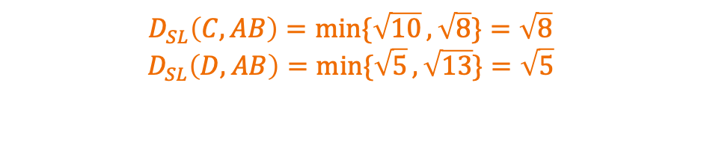
Example
What would merge next under single-link distance?
$$B\left(0,3\right)$$
$$D_{SL}\left(C,AB\right)=\min{\{\sqrt{10}},\sqrt{8}\}=\sqrt{8}$$
$$D_{SL}\left(D,AB\right)=\min{\{\sqrt{5}},\sqrt{13}\}=\sqrt{5}$$
$$\sqrt{13}$$
$$A\left(1,2\right)$$
$$\sqrt{5}$$
$$C\left(−1,0\right)$$
$$D\left(2,0\right)$$

Slide 11
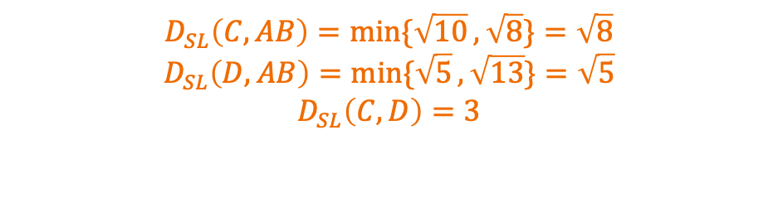
Example
What would merge next under single-link distance?
$$B\left(0,3\right)$$
$$D_{SL}\left(C,AB\right)=\min{\{\sqrt{10}},\sqrt{8}\}=\sqrt{8}$$
$$D_{SL}\left(D,AB\right)=\min{\{\sqrt{5}},\sqrt{13}\}=\sqrt{5}$$
$$D_{SL}\left(C,D\right)=3$$
$$A\left(1,2\right)$$
$$C\left(−1,0\right)$$
$$D\left(2,0\right)$$

Slide 12
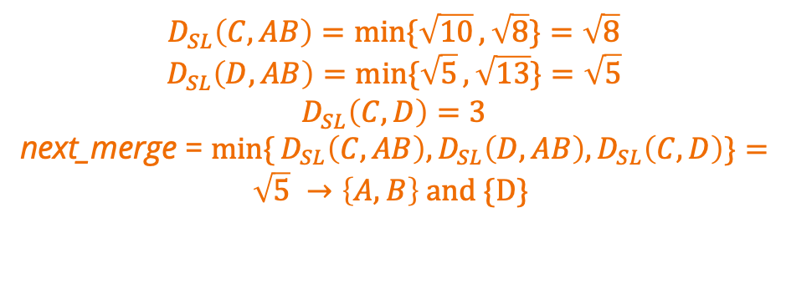
Example
What would merge next under single-link distance?
$$B\left(0,3\right)$$
$$D_{SL}\left(C,AB\right)=\min{\{\sqrt{10}},\sqrt{8}\}=\sqrt{8}$$
$$D_{SL}\left(D,AB\right)=\min{\{\sqrt{5}},\sqrt{13}\}=\sqrt{5}$$
$$D_{SL}\left(C,D\right)=3$$
next_merge = $\min{\{}D_{SL}\left(C,AB\right),D_{SL}\left(D,AB\right),D_{SL}\left(C,D\right)\}=\sqrt{5} →\left\{A,B\right\} and \{D\}$
$$A\left(1,2\right)$$
$$C\left(−1,0\right)$$
$$D\left(2,0\right)$$

Slide 13
Example
What would merge next under complete-link distance?
$$B\left(0,3\right)$$
$$A\left(1,2\right)$$
$$C\left(−1,0\right)$$
$$D\left(2,0\right)$$

Slide 14
Do not edit
How to change the design
What would merge next under complete-link distance?
The Slido app must be installed on every computer you’re presenting from

Slide 15

Example
What would merge next under complete-link distance?
$$B\left(0,3\right)$$
$$D_{CL}\left(C,AB\right)=\max{\{\sqrt{10}},\sqrt{8}\}=\sqrt{10}$$
$$A\left(1,2\right)$$
$$\sqrt{10}$$
$$\sqrt{8}$$
$$C\left(−1,0\right)$$
$$D\left(2,0\right)$$

Slide 16


Example
What would merge next under complete-link distance?
$$B\left(0,3\right)$$
$$D_{CL}\left(C,AB\right)=\max{\{\sqrt{10}},\sqrt{8}\}=\sqrt{10}$$
$$D_{CL}\left(D,AB\right)=\max{\{\sqrt{5}},\sqrt{13}\}=\sqrt{13}$$
$$\sqrt{13}$$
$$A\left(1,2\right)$$
$$\sqrt{5}$$
$$C\left(−1,0\right)$$
$$D\left(2,0\right)$$

Slide 17

Example
What would merge next under complete-link distance?
$$B\left(0,3\right)$$
$$D_{CL}\left(C,AB\right)=\max{\{\sqrt{10}},\sqrt{8}\}=\sqrt{10}$$
$$D_{CL}\left(D,AB\right)=\max{\{\sqrt{5}},\sqrt{13}\}=\sqrt{13}$$
$$D_{CL}\left(C,D\right)=3$$
$$A\left(1,2\right)$$
$$C\left(−1,0\right)$$
$$D\left(2,0\right)$$

Slide 18
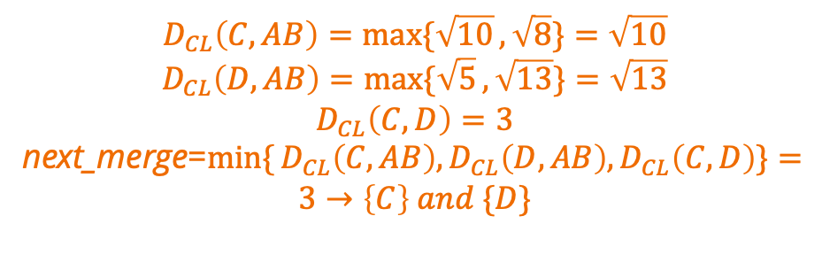
Example
What would merge next under complete-link distance?
$$B\left(0,3\right)$$
$$D_{CL}\left(C,AB\right)=\max{\{\sqrt{10}},\sqrt{8}\}=\sqrt{10}$$
$$D_{CL}\left(D,AB\right)=\max{\{\sqrt{5}},\sqrt{13}\}=\sqrt{13}$$
$$D_{CL}\left(C,D\right)=3$$
next_merge=$\min{\{}D_{CL}\left(C,AB\right),D_{CL}\left(D,AB\right),D_{CL}\left(C,D\right)\}=$
$$3→\left\{C\right\} and \{D\}$$
$$A\left(1,2\right)$$
$$C\left(−1,0\right)$$
$$D\left(2,0\right)$$

Slide 19
Hierarchical Clustering: Pros & Cons
Pros
  No need to pick k in advance
  The dendrogram shows cluster structure at every scale at once
  Works with any distance metric you can define
Cons
  Expensive — typically O(n²) time/space, doesn't scale to huge datasets
  Merges are permanent — an early bad merge can't be undone
  Sensitive to noise and outliers (especially single-link)

Slide 20
DBSCAN

Slide 21
Density-Based Clustering
Idea: clusters are dense regions of points, separated by sparser regions
Two parameters you choose:
  ε (epsilon) — the radius of a point's neighborhood
  min_pts — the minimum number of neighbors to count as “dense”
No need to specify the number of clusters ahead of time!

Slide 22
Categories of Points
Core point: has ≥ min_pts points within its ε-neighborhood
Border point: not core itself, but falls inside a core point's ε-neighborhood
Noise point: neither core nor border — it doesn't get assigned to any cluster

Slide 23
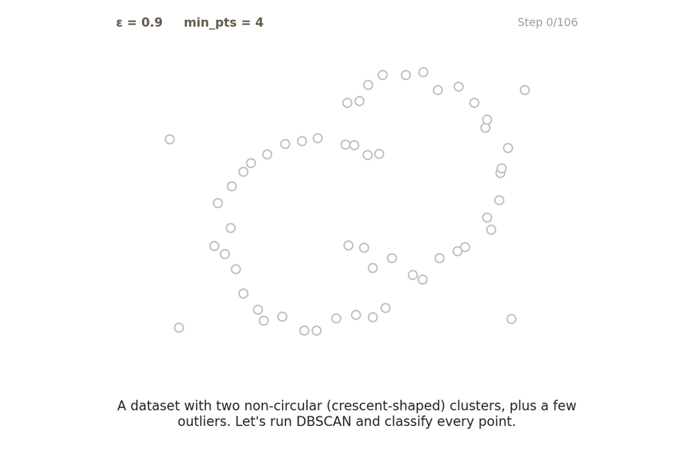
DBSCAN Visualized — Step by Step
Watch every point get an ε-neighborhood check — border points get promoted to core, others stay noise.

Slide 24
Pros and Cons of DBScan
  Pros:
  Finds clusters of arbitrary shape — not just round blobs like K-means
  Robust to noise and outliers — they're explicitly labeled as noise, not forced into a cluster
  Doesn't require specifying the number of clusters ahead of time
  Cons:
  Still need to choose ε and min_pts — results are sensitive to both
  Struggles when clusters have very different densities

Slide 25
Do not edit
How to change the design
min_pts = 5. Point p has 3 points in its ε-neighborhood, and one of those 3 is itself a core point. What is p?
The Slido app must be installed on every computer you’re presenting from

Slide 26
Do not edit
How to change the design
Which type of point can end up assigned to a different cluster depending on the order DBSCAN happens to visit points in?
The Slido app must be installed on every computer you’re presenting from

Slide 27
Do not edit
How to change the design
You keep min_pts fixed and increase ε. What's the most likely effect?
The Slido app must be installed on every computer you’re presenting from

Slide 28
Silhouette Scores

Slide 29
Recall: How Do We Choose k?
Iterate over different k's and look for the point of diminishing returns in cost (“elbow method”)
Use empirical or domain-specific knowledge
Use a metric that scores the quality of a clustering output
  Silhouette scores!

Slide 30
Definitions
For each data point i:
  aᵢ = mean distance from i to every other point in its own cluster
  bᵢ = smallest mean distance from i to the points of any other cluster
Intuitively: aᵢ measures how well i fits where it is; bᵢ measures how well it would fit its best alternative

Slide 31
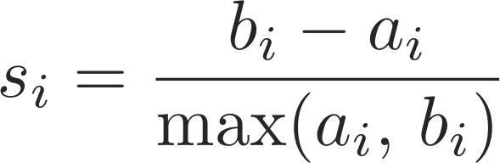
Putting It Together
Tells us how well point i fits its own cluster compared to its next-best alternative
Average sᵢ over every point to get one score for the whole clustering

Slide 32
Interpreting the Silhouette Score
When does sᵢ → 1?

Slide 33
Interpreting the Silhouette Score
When does sᵢ → 1?
  aᵢ ≪ bᵢ: i is much closer to its own cluster than to any other → a great fit

Slide 34
Interpreting the Silhouette Score
When does sᵢ → 1?
  aᵢ ≪ bᵢ: i is much closer to its own cluster than to any other → a great fit
When does sᵢ → 0?

Slide 35
Interpreting the Silhouette Score
When does sᵢ → 1?
  aᵢ ≪ bᵢ: i is much closer to its own cluster than to any other → a great fit
When does sᵢ → 0?
  aᵢ ≈ bᵢ: i sits right on the boundary between two clusters

Slide 36
Interpreting the Silhouette Score
When does sᵢ → 1?
  aᵢ ≪ bᵢ: i is much closer to its own cluster than to any other → a great fit
When does sᵢ → 0?
  aᵢ ≈ bᵢ: i sits right on the boundary between two clusters
When does sᵢ → −1?

Slide 37
Interpreting the Silhouette Score
When does sᵢ → 1?
  aᵢ ≪ bᵢ: i is much closer to its own cluster than to any other → a great fit
When does sᵢ → 0?
  aᵢ ≈ bᵢ: i sits right on the boundary between two clusters
When does sᵢ → −1?
  aᵢ ≫ bᵢ: i is actually closer to another cluster than its own → likely mis-clustered

Slide 38
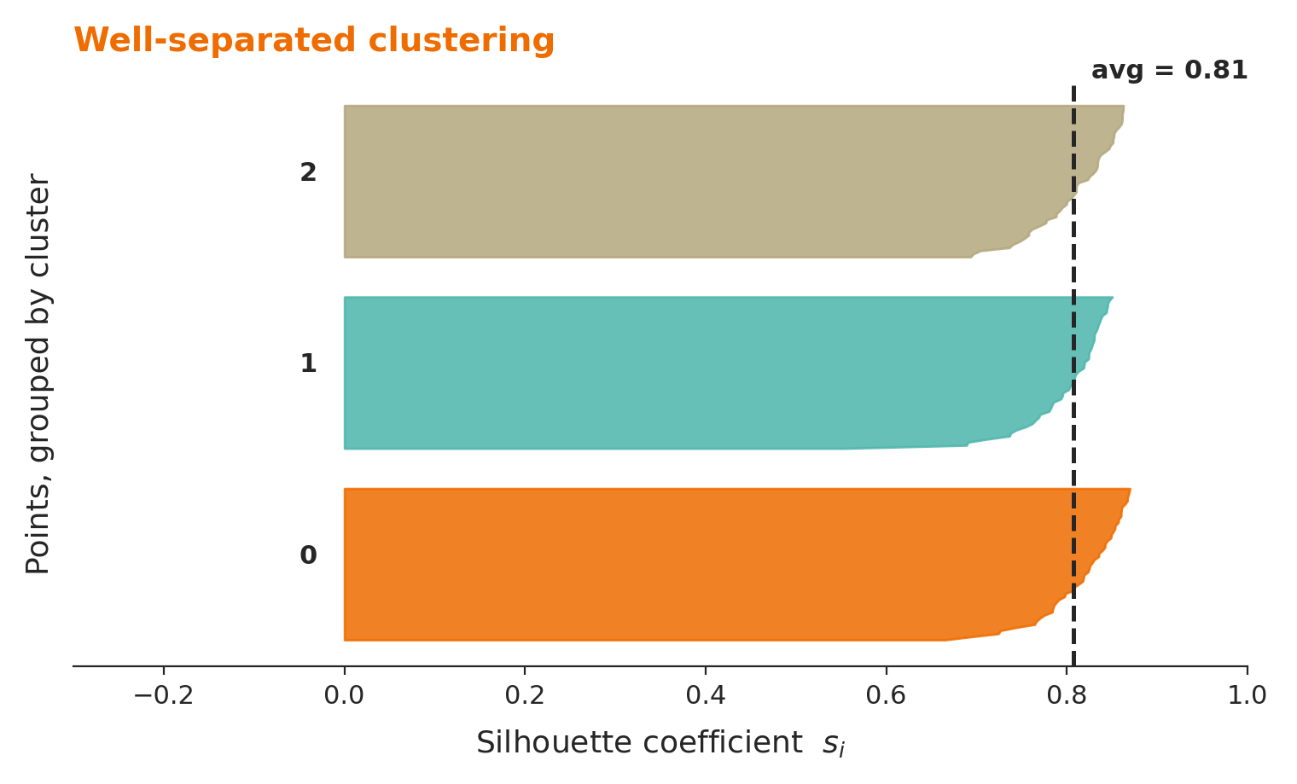
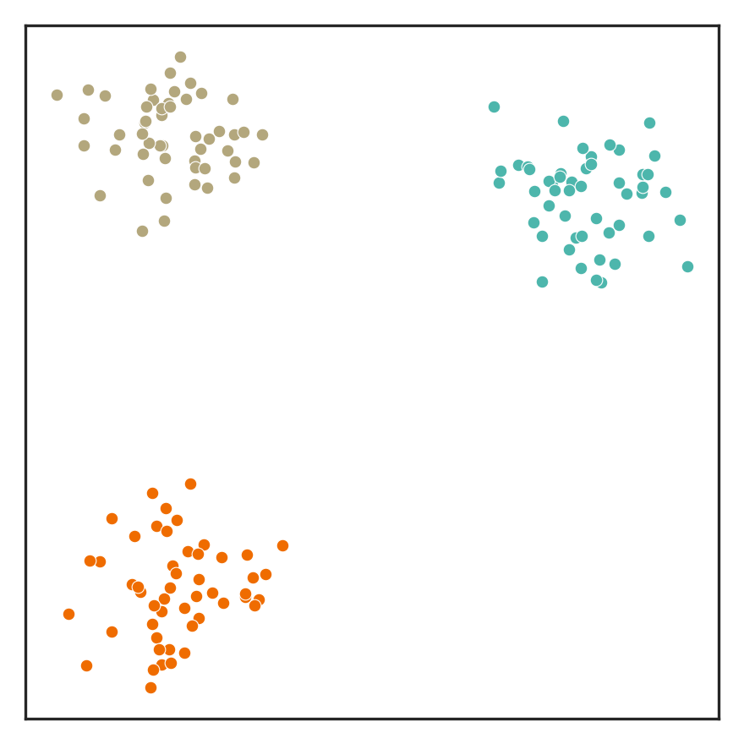
Silhouette Plot — Well-Separated Clustering
Each colored band is one cluster; within a band, points are sorted by score. Tall, wide bands near 1 with the dashed average far to the right = a strong clustering.
Notes:
Each bin represents a cluster; the y-axis groups points by cluster; the x-axis is that point's silhouette score, sorted within each band.

Slide 39
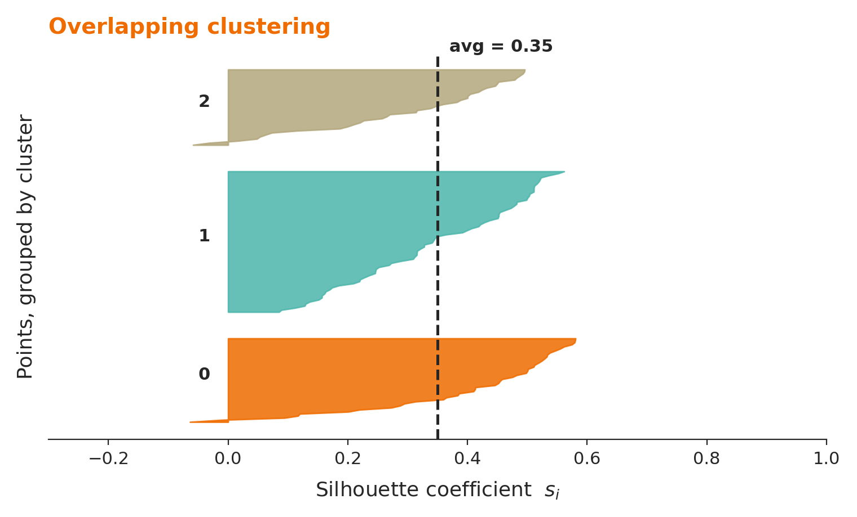
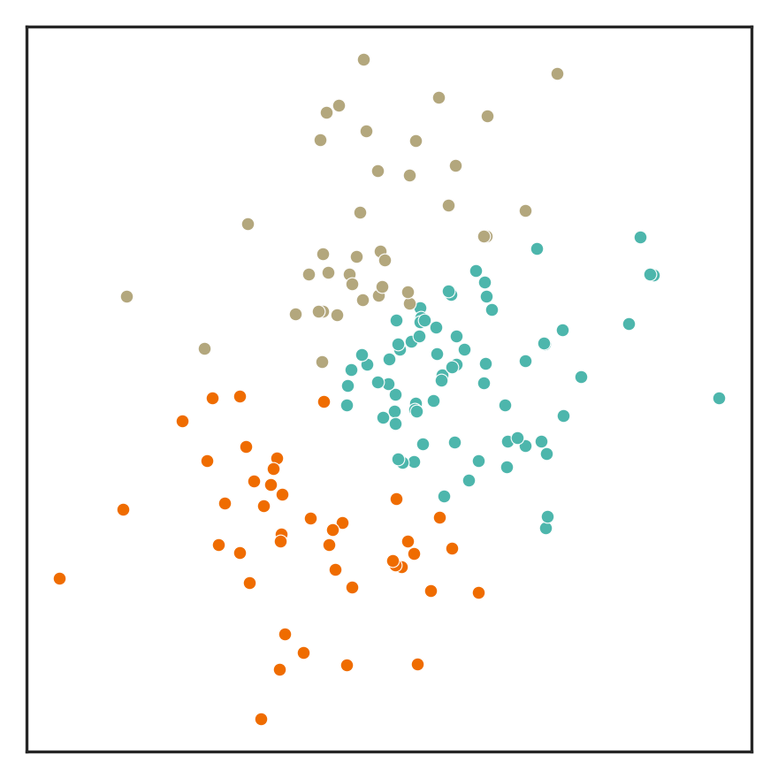
Silhouette Plot — Overlapping Clustering
Thinner bands, scores clustered near 0, and a lower average — these points don't fit their assigned clusters nearly as cleanly.

Slide 40
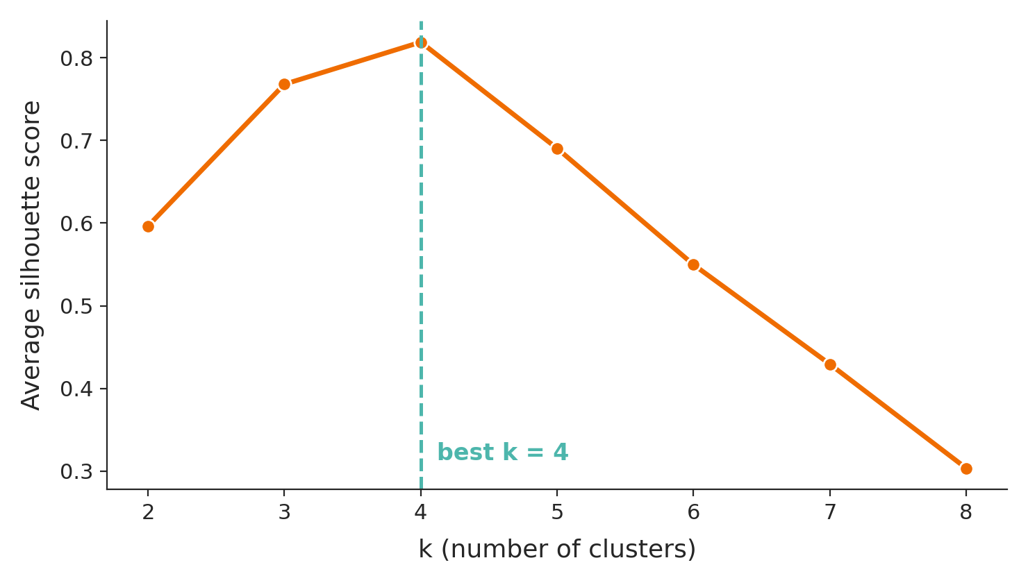
Using Silhouette Scores to Choose k
Run the clustering for a range of k, compute the average silhouette score each time, and pick the k that maximizes it.

Slide 41
Questions?

